Slide 1
Presentation on java
By saikumar

Slide 2
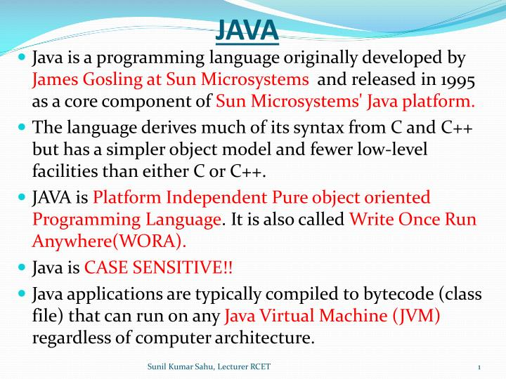

Slide 3
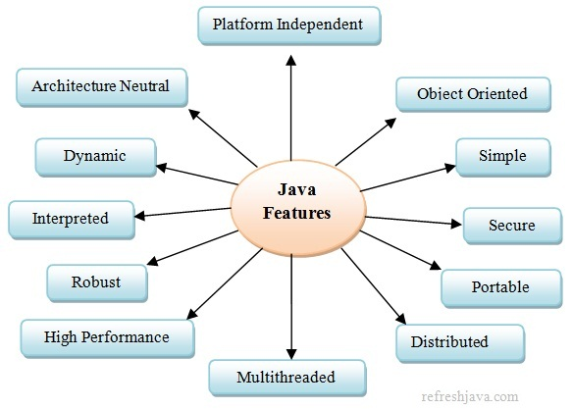

Slide 4
Hello World
class Simple{
public static void main(String args[]){
System.out.println("Hello World Java");
}
}

Slide 5
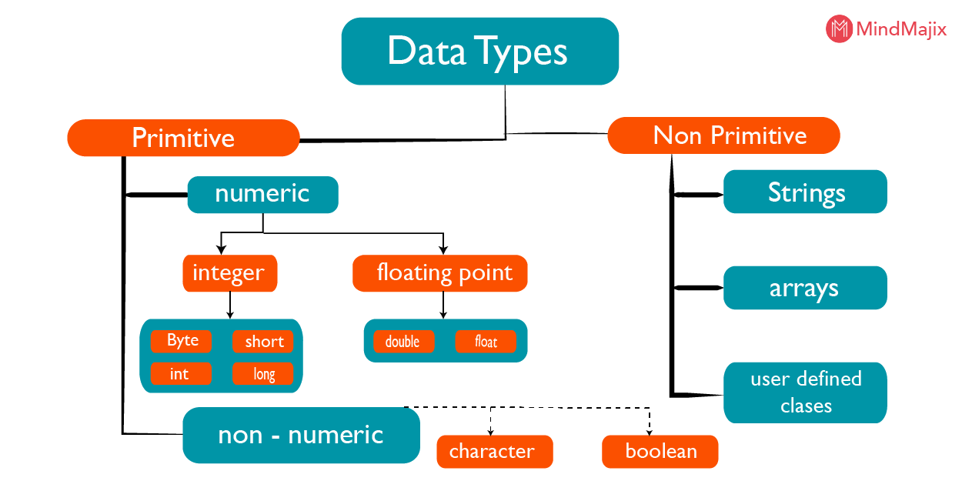

Slide 6
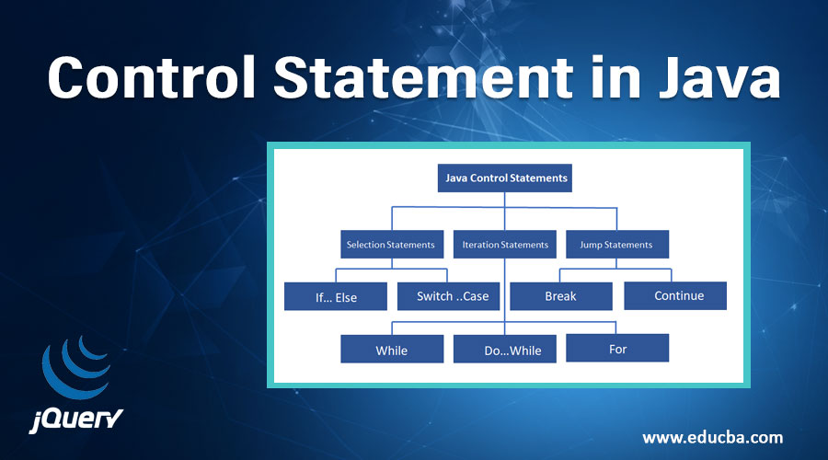

Slide 7
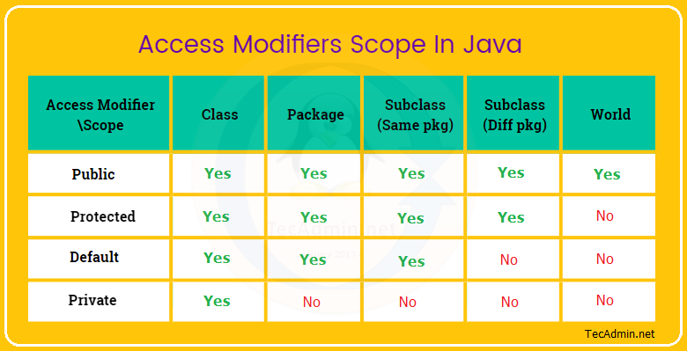

Slide 8
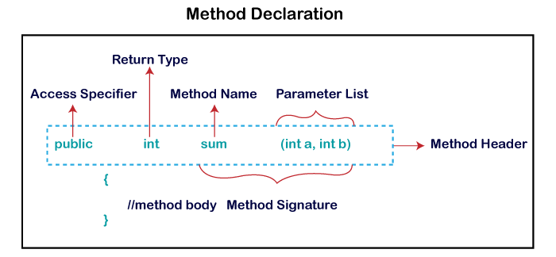

Slide 9
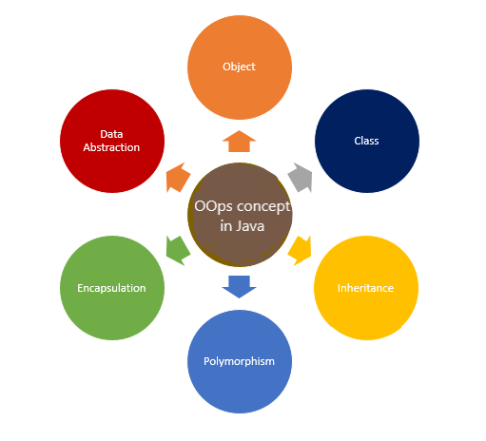

Slide 10
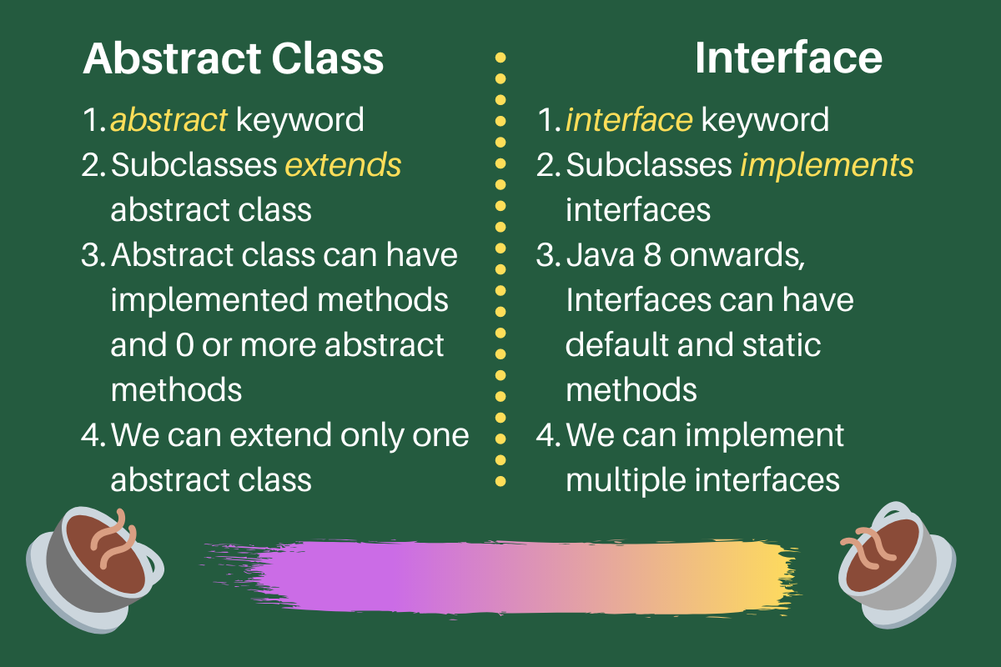

Slide 11
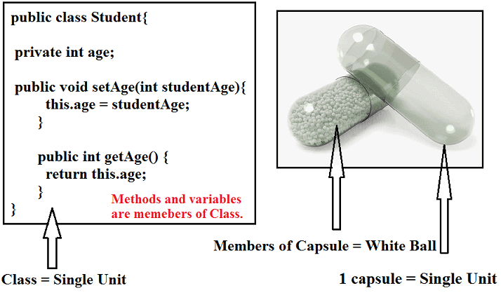
Encapsulation

Slide 12
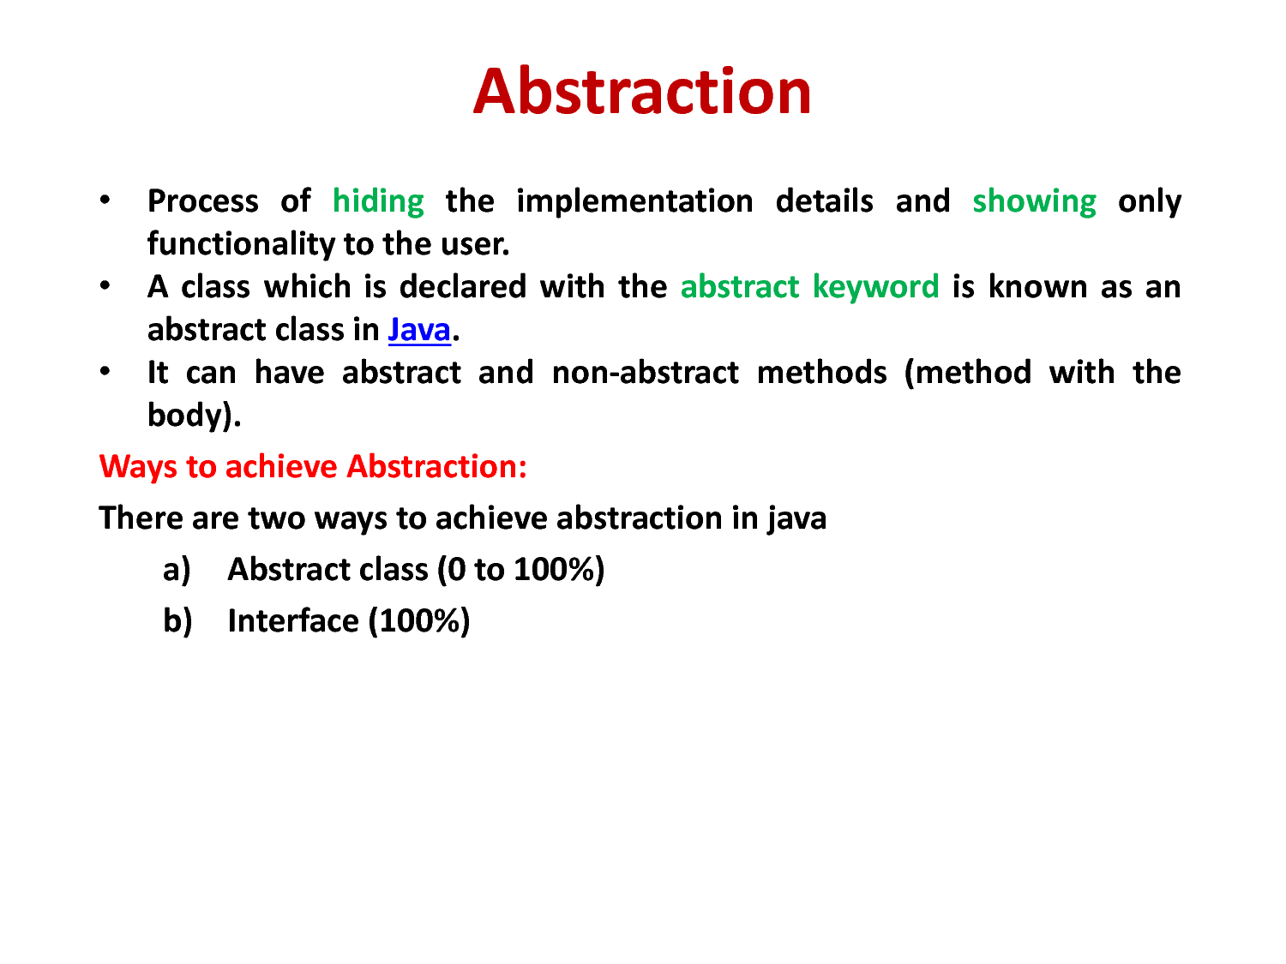
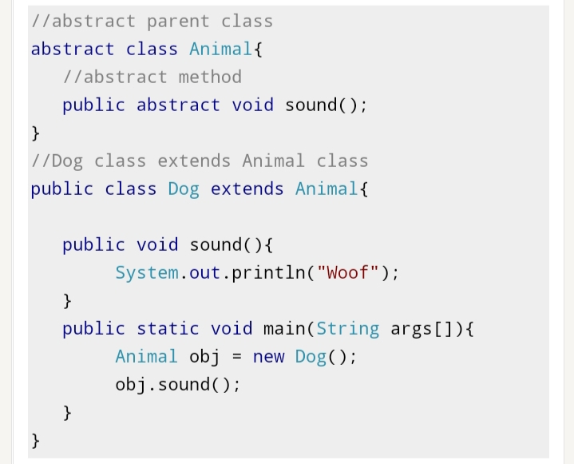
Abstraction

Slide 13
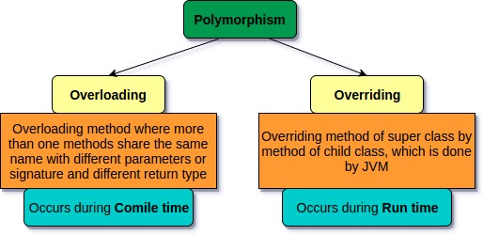

Polymorphisam

Slide 14
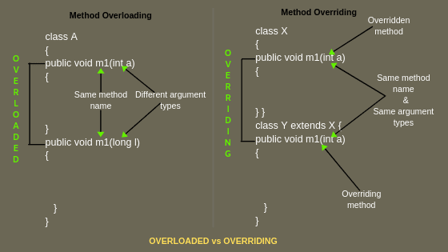

Slide 15
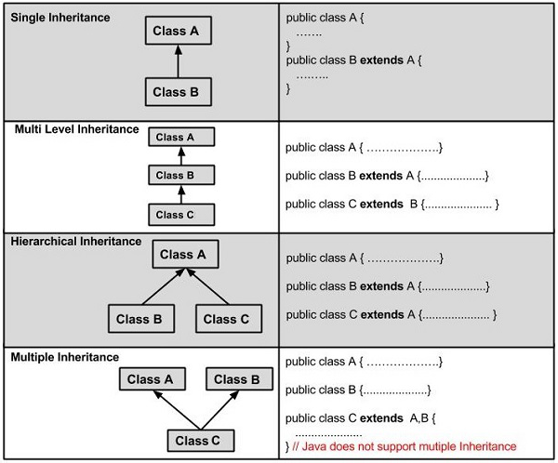
Inheritance Types

Slide 16
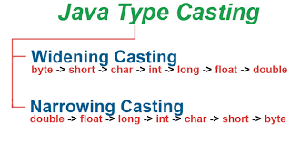
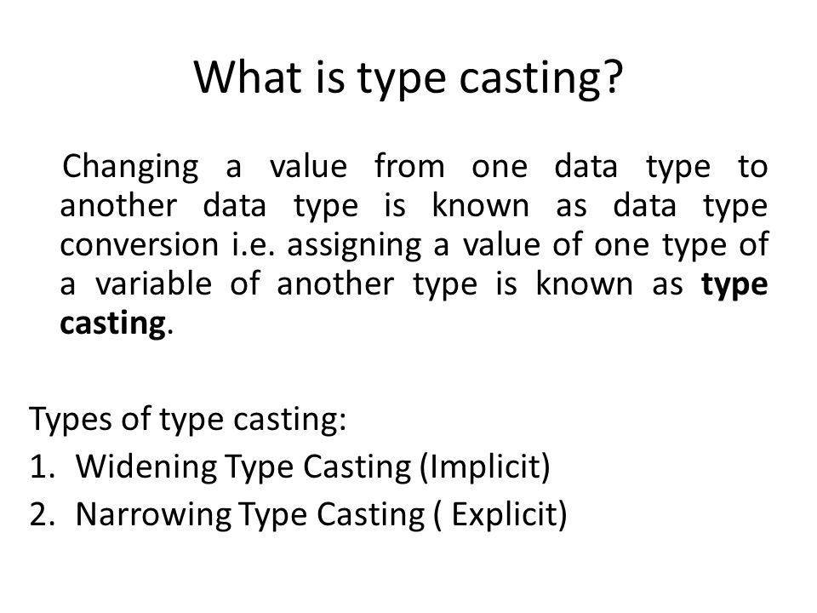
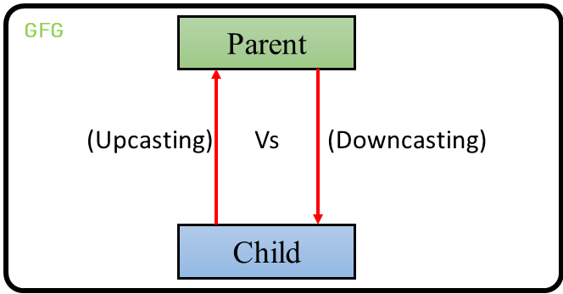
Type Casting

Slide 17
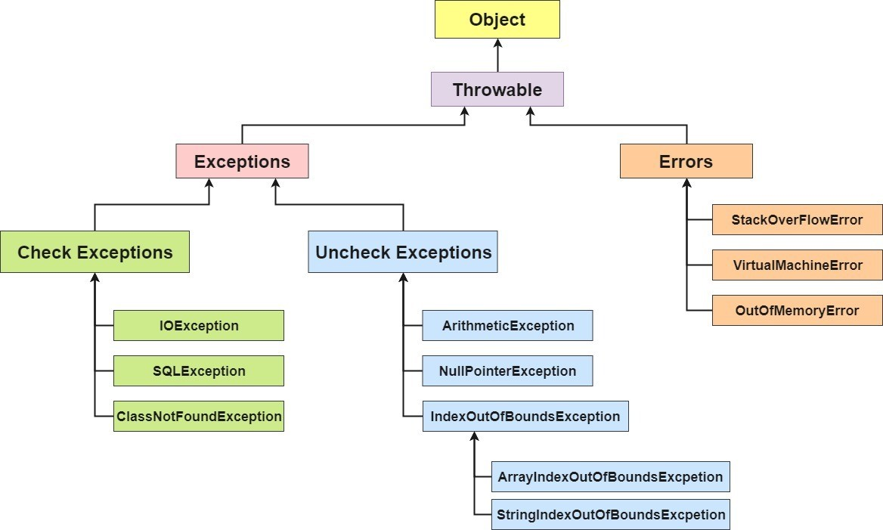
Exception Hierarchy

Slide 18
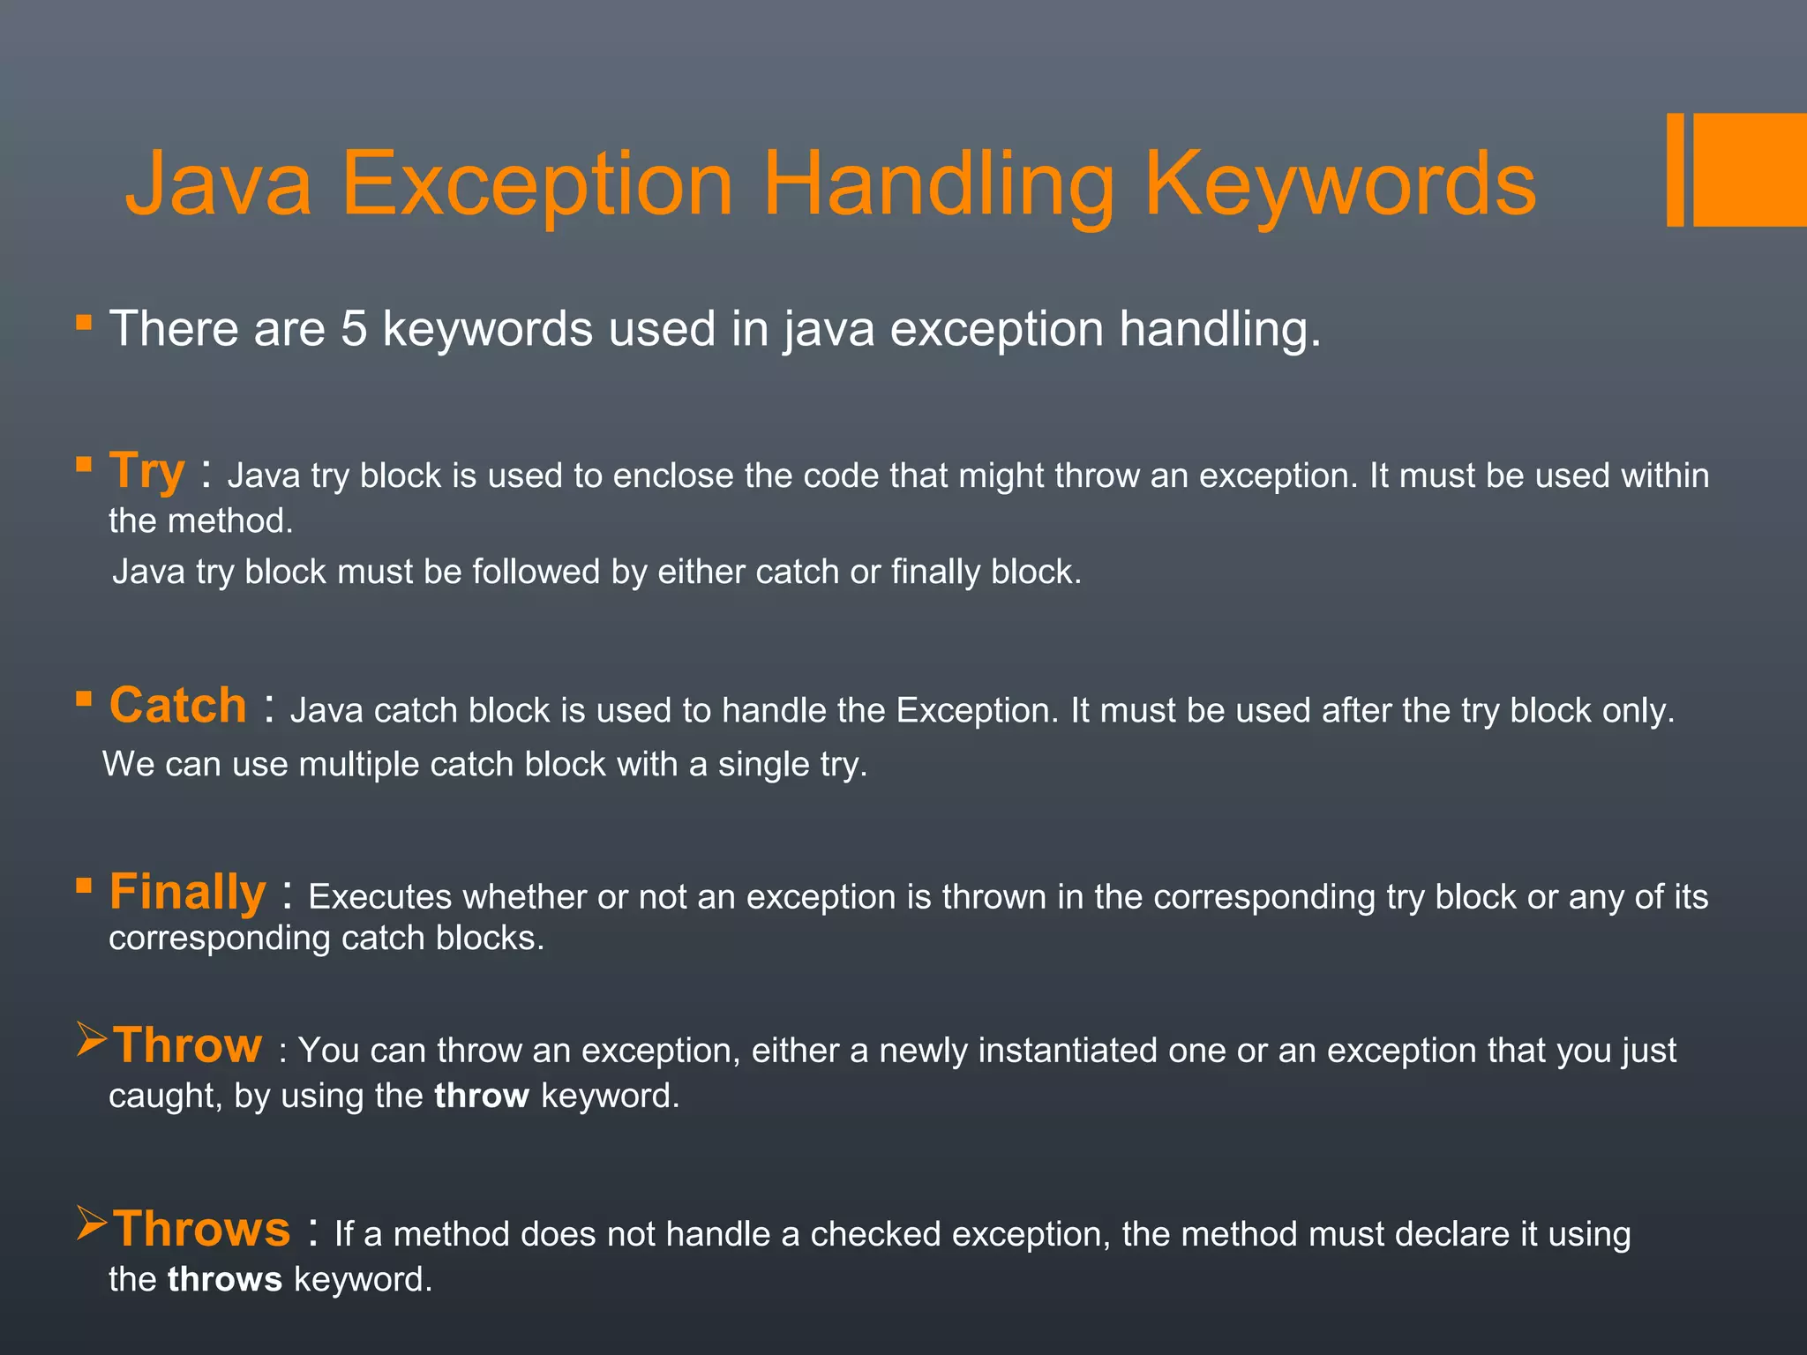
Try

Slide 19
Collections
The Collection in java is a framework that provides an architecture to store and manipulate the group of objects.
Java Collections can achieve all the operations that you perform on a data such as searching, sorting, insertion, manipulation and deletion.
Java Collection means a single unit of objects. Java Collection framework provides many interfaces(Set, List, Queue) and classes(ArrayList, LinkedList, HashSet, Sorted, LinkedHashSet, TreeSet ).

Slide 20
Collection Hierarchy

Slide 21
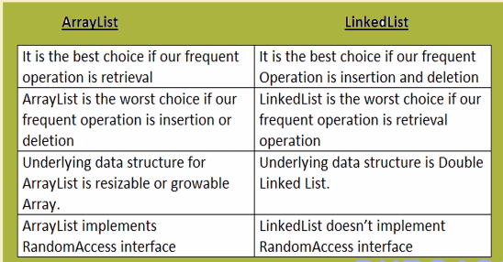
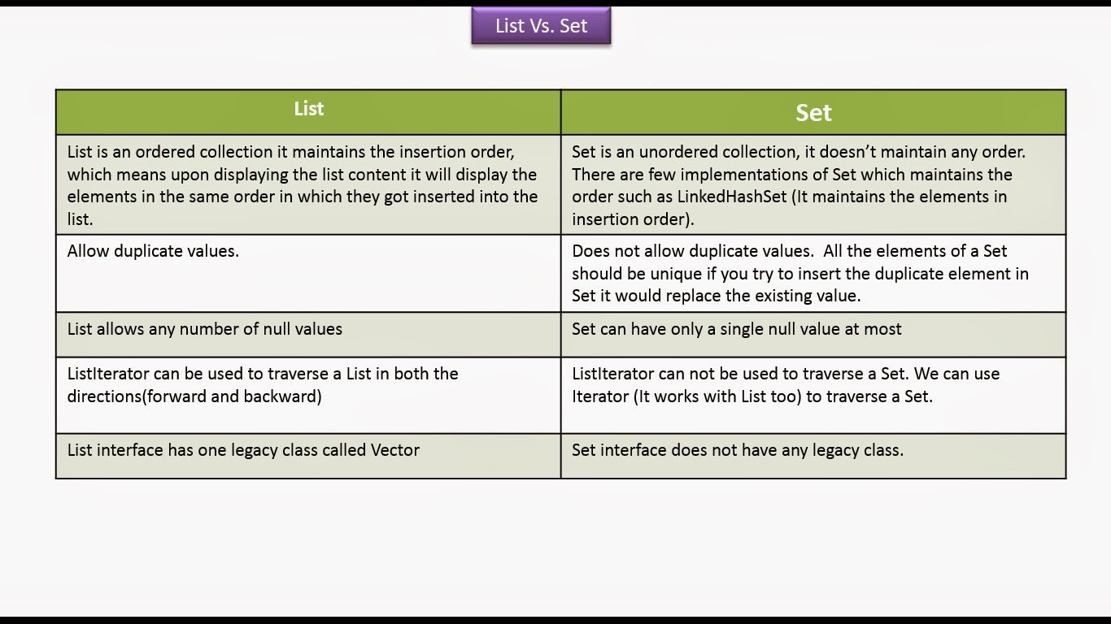

Slide 22
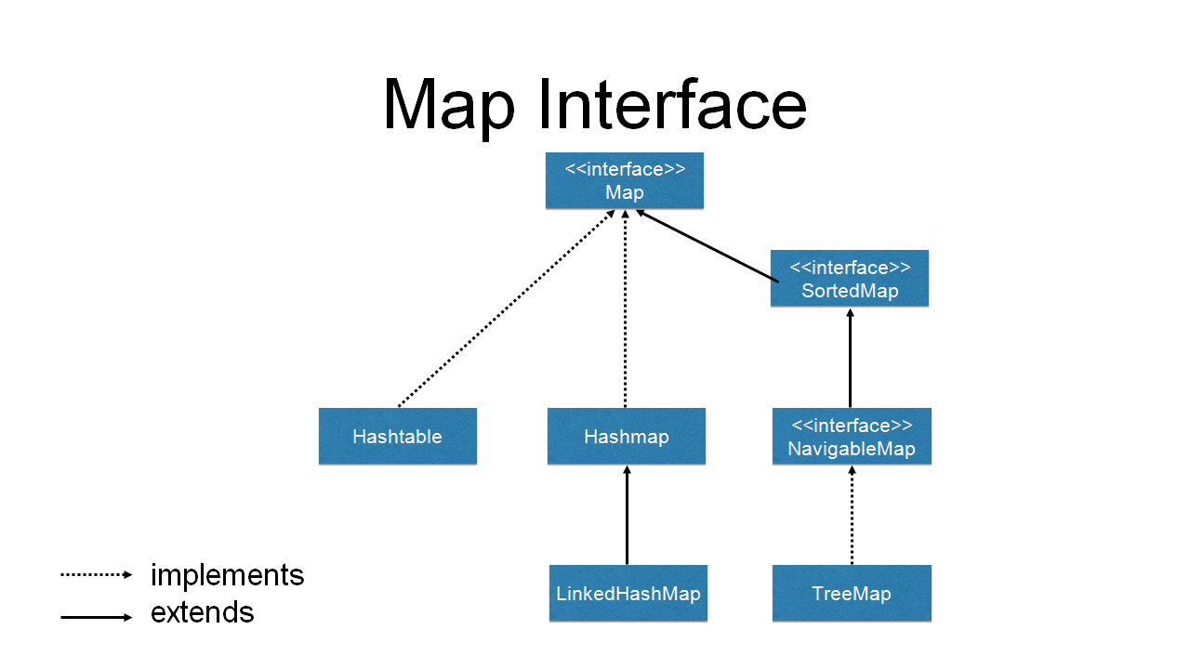

Slide 23
Map
The Map interface in the Java Collections Framework represents a collection of key-value pairs, where each key is associated with a corresponding value. It provides methods to store, retrieve, and manipulate the key-value mappings. Here are some key points about the Map interface:
Key-Value Pairs: The Map interface stores elements as key-value pairs. Each key in the map is unique, and it is used to retrieve the associated value. Keys and values can be of any non-null reference type.
No Duplicate Keys: A Map does not allow duplicate keys. If you attempt to add a key-value pair with a key that already exists in the map, the new value will replace the existing value associated with that key.

Slide 24
Generics
Generics makes the code stable by delecting the bugs at compile time.Using Generics, it is possible to create clasees that work with different data types.
Advantages of Generics:
1) Type-safety
2) Type casting is not required
3) Compile-Time Checking
Wildcard in Generics:
The ? (question mark) symbol represents the wildcard element. It means any type.

Slide 25
class Test<T> {
T obj;
Test(T obj) { this.obj = obj; }
public T getObject() { return this.obj; }
}
class Main {
public static void main(String[] args)
{
Test<Integer> iObj = new Test<Integer>(18);
System.out.println(iObj.getObject());
Test<String> sObj
= new Test<String>("virat");
System.out.println(sObj.getObject());
}
}
Output: 15
virat

Slide 26
Thank you...

